Slide 1
FTD Basics
This presentation can be downloaded from: http://tinyurl.com/ftdclass
Password is: FTDFERoadshow
Training around FTD version 6.1 release
Dax Mickelson
dmickels@cisco.com

Slide 2
Logistics
Bathrooms
Coffee/Water/Drinks
Internet Access
Day 1
9AM: Lecture
10AM-Noon: Lab
Noon-1PM: Lab and lunch
1PM-2PM: Lecture
2PM-6PM: Lab
Day 2 (rinse, repeat)
9AM: Lecture
10AM-Noon: Lab
Noon-1PM: Lab and lunch
1PM-2PM: Lecture
2PM-6PM: Lab

Slide 3
Lecture Format
1 hour lecture followed by a 10 minute break.
Rinse, repeat (This is a 4 hour lecture so 4 one-hour sections with 3 ten-minute breaks.)
Use Q&A to ask questions and the panelists will respond.
Lab Format
Your lab will either start directly after this lecture or it will start on Wednesday February 1st. Check your invite to figure out which is for you.

Slide 4
Agenda
Introduction to NGFW
Delivery Options
Licensing
FTD Intro and Benefits
FTD Initialization and Mgmt Config.
FTD Configuration Options
FTD to FMC Registration
FTD Deployment Modes
FTD Security Zones
NAT on FTD
Access Control Policy
ACP Rules
URL Filtering
SafeSearch / YouTube
Malware & File Policy
SSL Policy
Intrusion Policy
Rate Limiting
Network Discovery
FTD Packet Flow
Reports and Reporting
VPN on FTD
API
Upgrade ASA to FTD Code
Set up Firepower Device Manager
Cisco Healthcheck & Tuning Services
Questions?

Slide 5
NGFW: What it is and why its important

Slide 6
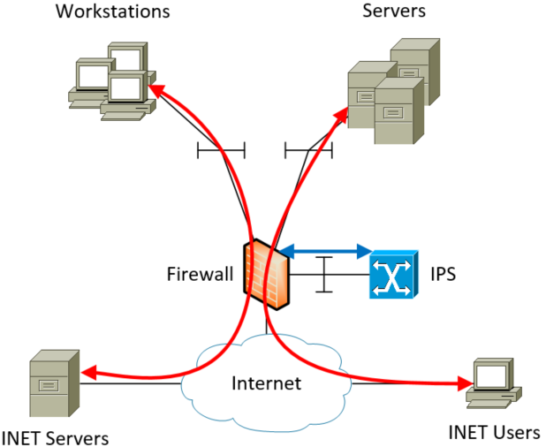
Traditional Security
Firewall
Security Levels
ACLs using L3/L4 protocol
NAT
IPS
Inline or “to the side”
Use signatures to detect patterns

Slide 7
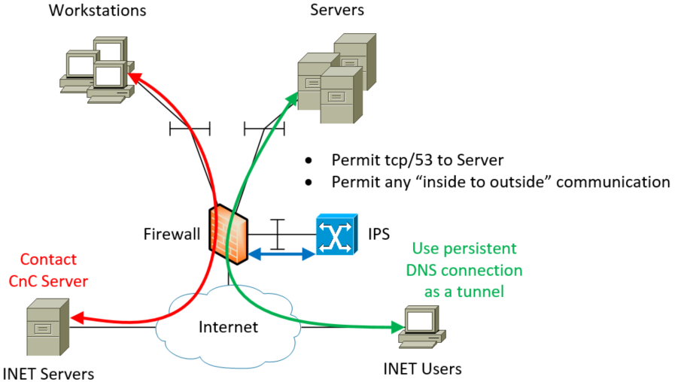
Traditional Security (cont.)
ICMP tunnels
DNS tunnels
Reverse SSH tunnels
Communication with Command and Control servers
HTTP is the new TCP

Slide 8
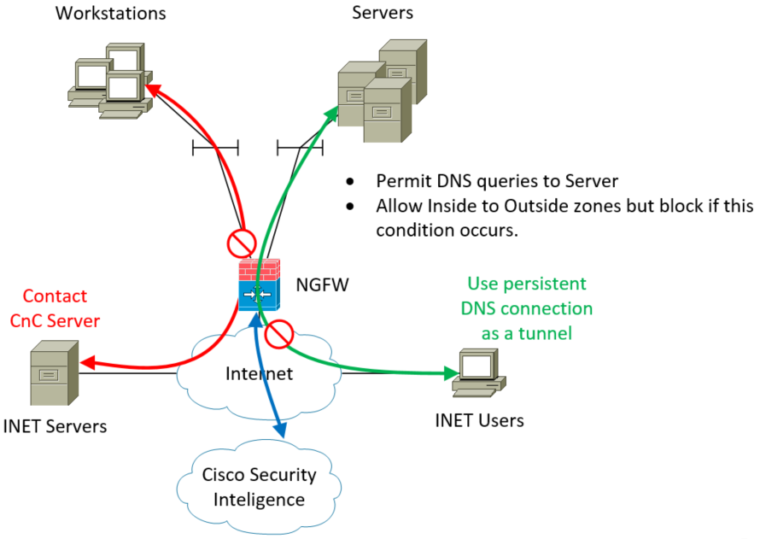
Marriage of Firewall and IPS -- NGFW
Tight integration of ASA firewall and Firepower (SNORT) IPS.
Regular updates of signatures and lists from Cisco Talos and other security monitors.

Slide 9







Introduction to NGFW
World’s most widely deployed, enterprise-class ASA stateful firewall
Granular Cisco® Application Visibility and Control (AVC)
Industry-leading FirePOWER next-generation IPS (NGIPS)
Reputation- and category-based URL filtering
Advanced malware protection
Cisco Collective Security Intelligence Enabled
WWW
Advanced Malware Protection
(Subscription)
Clustering & High Availability
Intrusion Prevention (Subscription)
URL Filtering
(Subscription)
FireSIGHT
Analytics & Automation
Network Firewall
Routing | Switching
Application Visibility & Control
Built-in Network Profiling
Identity-Policy Control & VPN
Cisco ASA

Slide 10
Delivery Options

Slide 11
NGFW Delivery Options
Hardware:
ASA with FirePower Services
ASA and FirePOWER (independent servers)
Firepower Threat Defense (FTD)
Virtual Machine:
ASAv and Firepower Virtual Appliance (independent VMs)
vFTD

Slide 12
Licensing

Slide 13
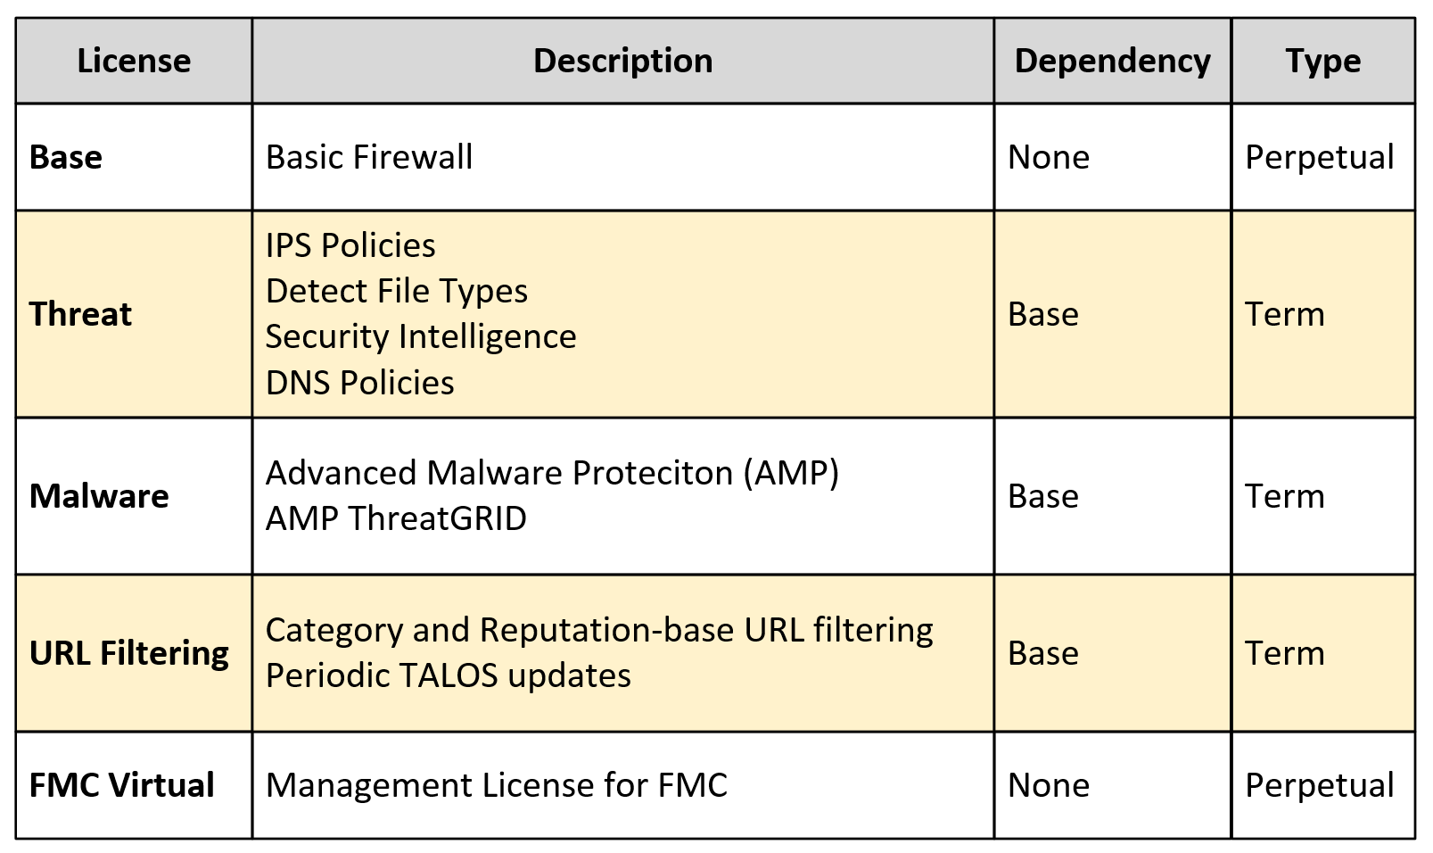
Licensing

Slide 14
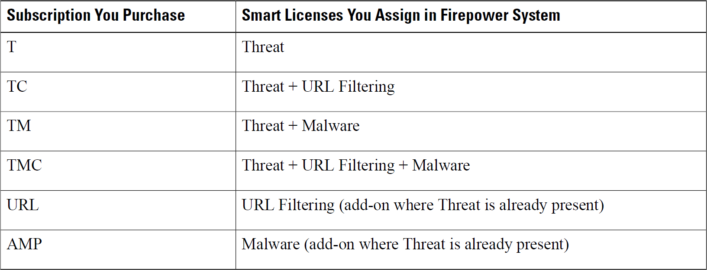
Licensing (cont.)

Slide 15
Firepower Threat Defense (FTD): Introduction and Benefits

Slide 16
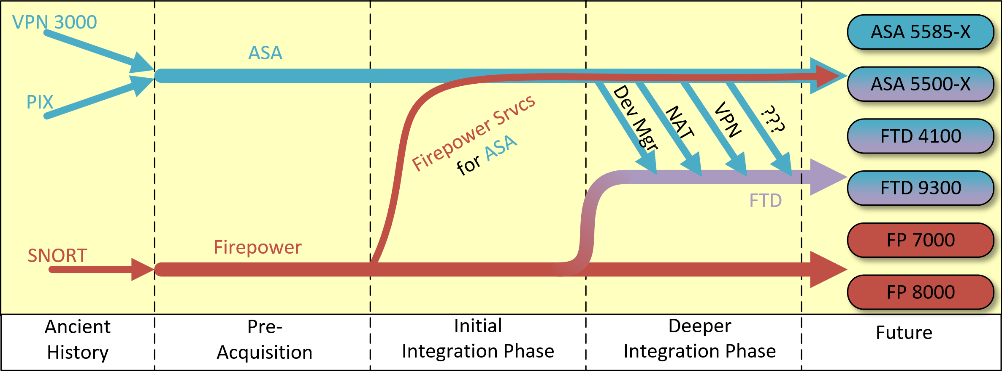
Evolution of NGFW

Slide 17
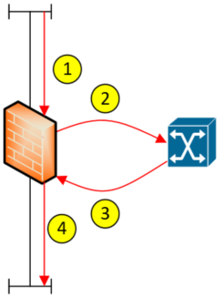
Current NGFW – Rough Packet Flow
Ingress to firewall
Copy packet to IPS for inspection
Serialization delay of packet
Down protocol stack in firewall and backup stack in IPS
Copy packet back to firewall
Serialization delay of packet and result
Down protocol stack in IPS and backup stack in firewall
Egress firewall

Slide 18
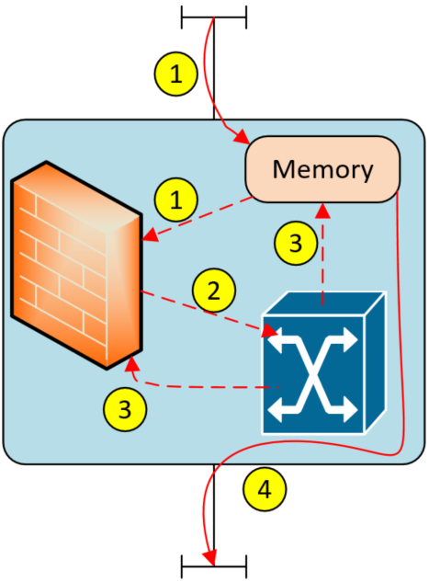
FTD– Rough Packet Flow
Ingress into server put into memory. Memory point sent to firewall process.
Firewall process runs checks against packet at that memory pointer and then sends memory pointer IPS process.
IPS process runs checks against packets at that memory pointer and sends result to firewall process.
Firewall process sends packet to server for egress.

Slide 19
Firepower Threat Defense (FTD): Initialization and Configuration

Slide 20
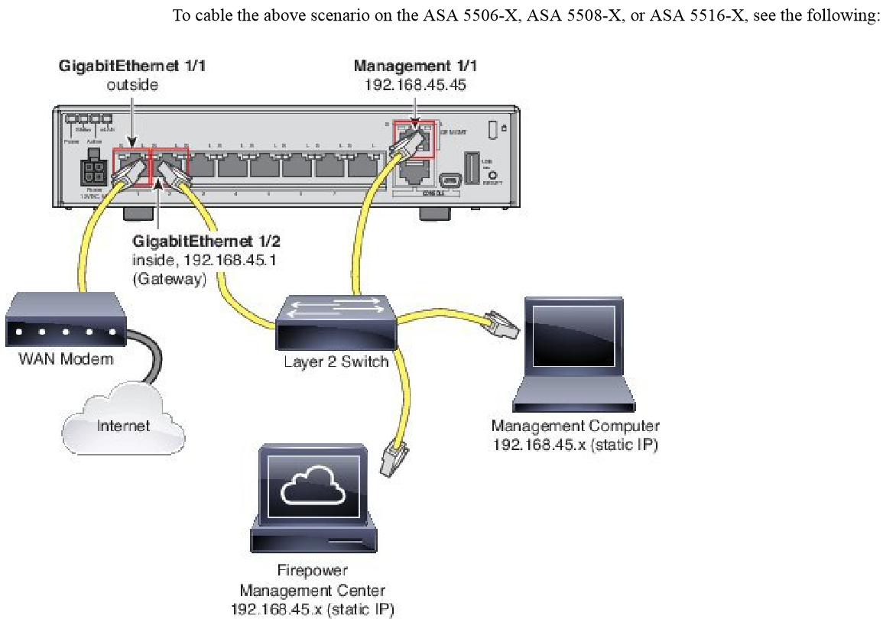
Management NIC
Must use Management Interface for configuration.
No CLI config mode – for data plane.
Management NIC in “VRF”.

Slide 21
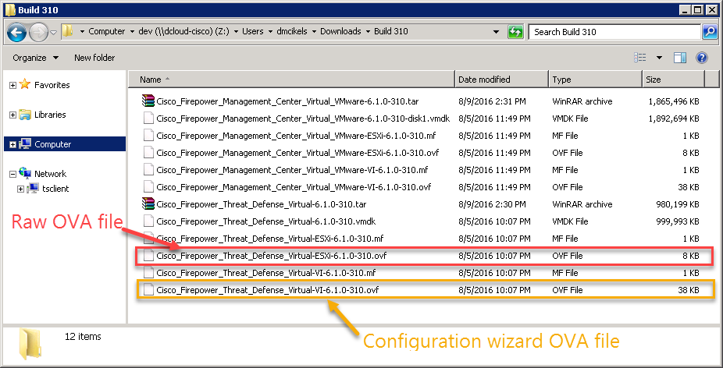
Deploy FTD (virtual machine)

Slide 22
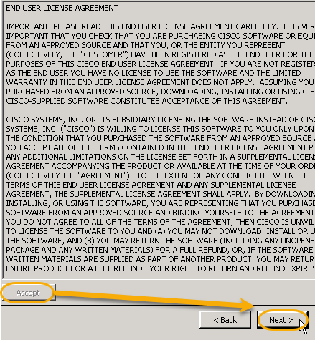
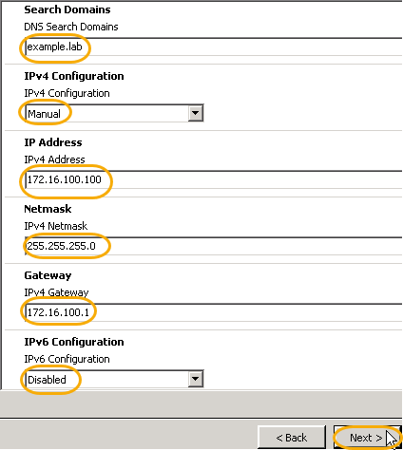
OVA with Configuration Wizard

Slide 23
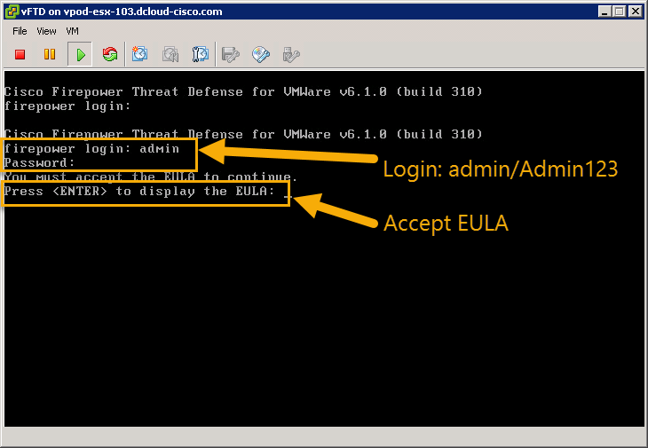
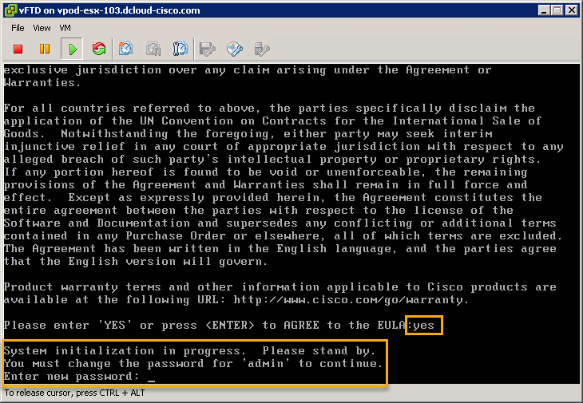
Management NIC Configuration

Slide 24
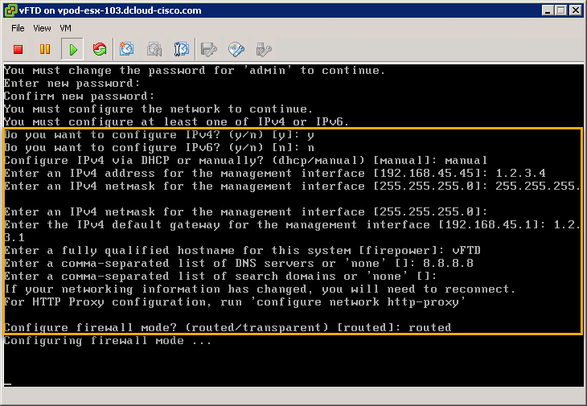
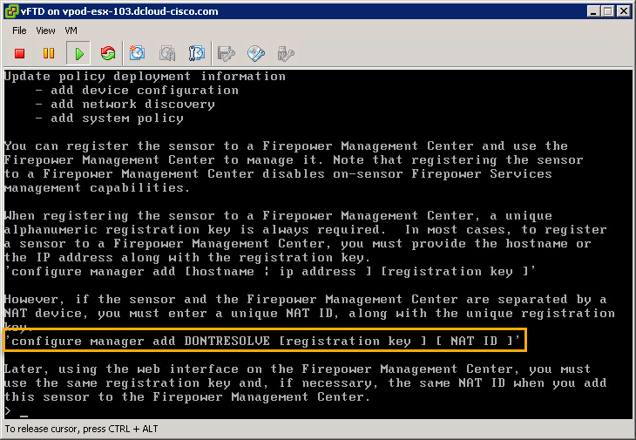
Management NIC Configuration (cont.)
Note: There is no “restarting” or “rerunning” the configuration wizard. You’ll have to use the CLI commands that start with configure network to change the management NIC’s configuration.

Slide 25
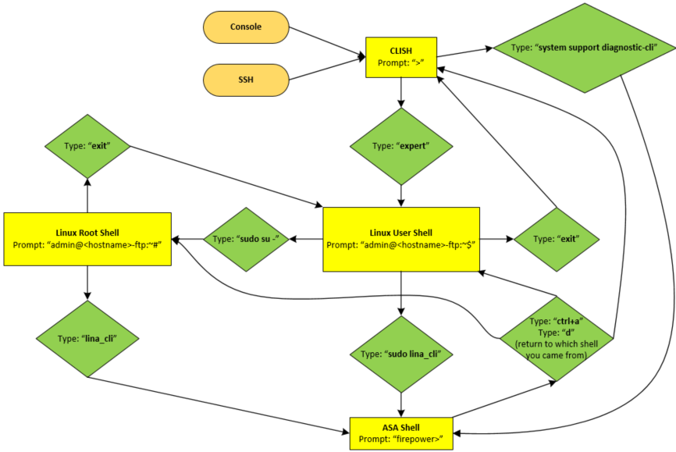
FTD CLI
3 “shells” that you can access:
FTD shell (AKA CLISH) – “>”
Linux shell (AKA BASH)
Non-root – “$”
Root – “#”
ASA Shell (AKA Lina CLI) – “firepower>”

Slide 26
FTD Configuration Options: FMC vs. Firepower Device Manager

Slide 27
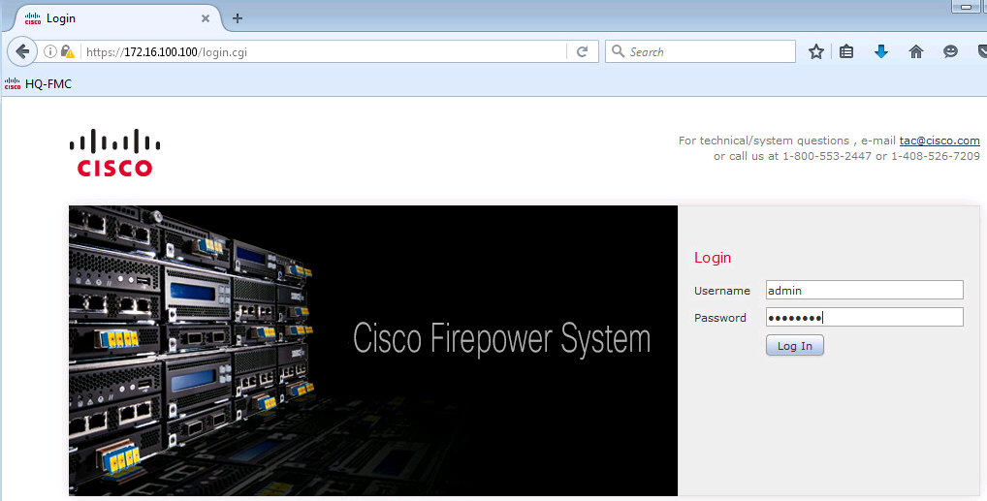
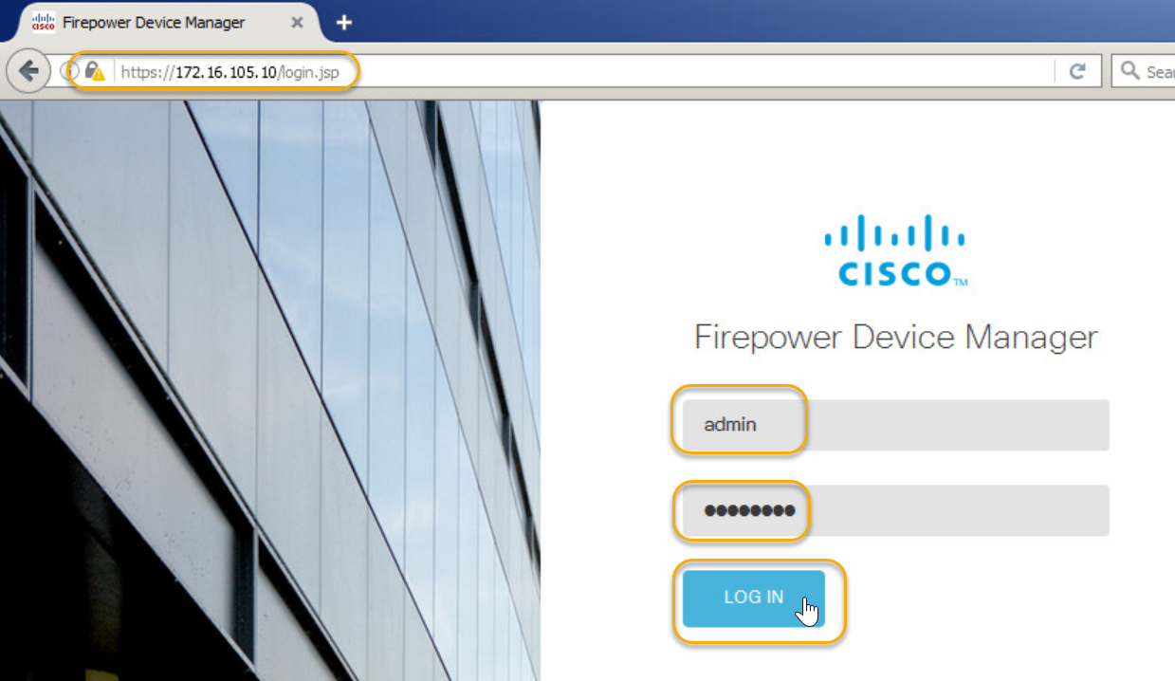
Data Plane Configuration Options
Firepower Management Center
Firepower Device Manager
Firepower Management Center (FMC): Centralized server for managing multiple devices
Firepower Device Manager: On-box manager for a single FTD device. (5500-X Hardware only.)

Slide 28
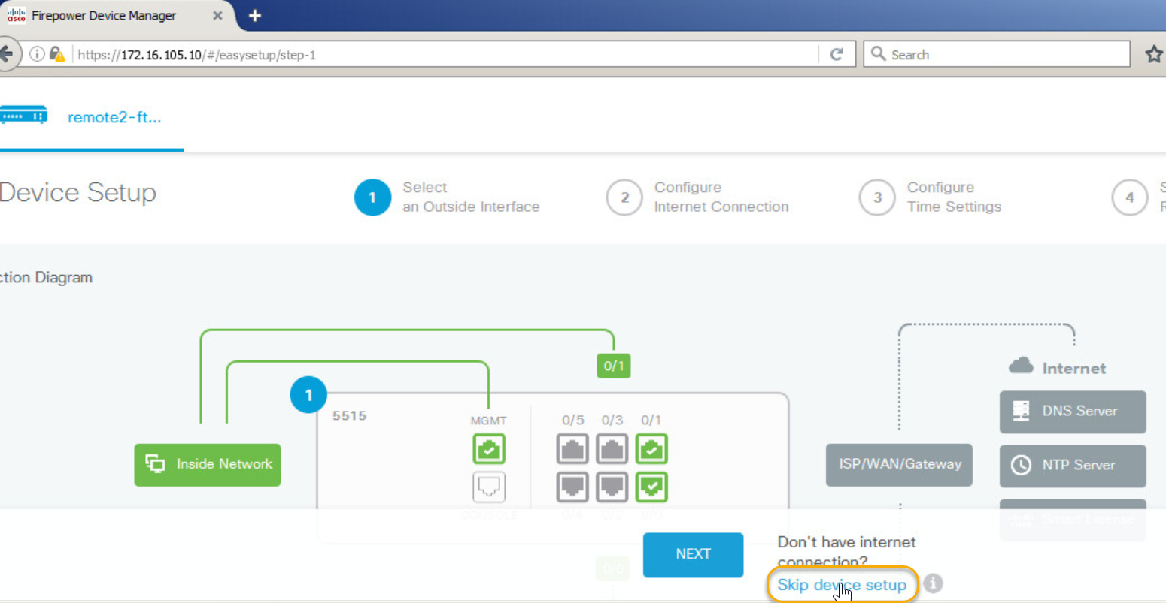
Firepower Device Manager
Not as feature rich as FMC, especially in reporting.
Supported Features as of v6.1:
NAT
Routing
Access Control
Device and Event Monitoring
Easy Device Setup
Roadmap:
Site to Site VPN
Security Intelligence
SSL, Identity, Rate Limiting (QoS), etc.
Active/Passive Authentications
No Current Plan:
Threat Intelligence and Analytics
Risk Reports
Correlation and Remediation

Slide 29
Firepower Management Center (FMC)
Centralize manager that allows common configuration across several devices.
Configure once, deploy to many.
Doesn’t manage ASA.
Manages Firepower and FTD devices.
Communicates with managed device via TCP/8305.
Can receive updates via “cloud” services, such as Cisco Talos.
Offline update available too if direct INET access not allowed.

Slide 30
FTD to FMC Registration

Slide 31
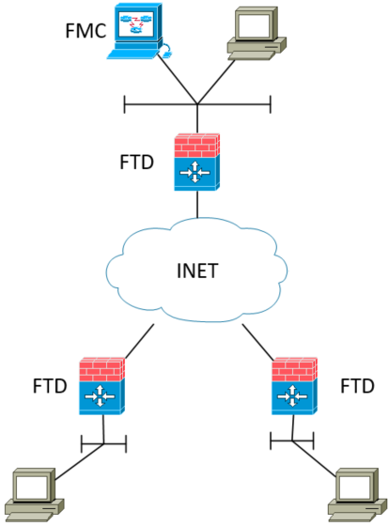
FMC Registration
FMC can be L2 adjacent or separated via L3.
Management NIC needs a route to the FMC though (aside from the data plane configuration).
Use CLI command configure manager add (with options) to configure FTD to register with FMC.
FMC needs configure to know about this FTD box too (no auto registration).
FTD connects to FMC on TCP/8305.

Slide 32
FMC Registration (cont.)
What about remote FTDs though?
Have pre-existing L3 route (maybe via MPLS) to FMC.
Pre-stage FTD in a development network and have FMC communication go over VPN or some such. ← DANGEROUS!!!
Put the Management NIC on the Public Internet.
Use Firepower Device Manager (single box management).
Where to cable the Management NIC?

Slide 33
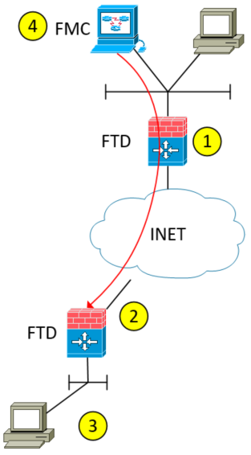
Static IP on Management NIC
Configure outbound access for FMC through existing edge device.
No static NAT entry required in this configuration.
Cable and configure Management NIC on INET side.
Use a static IP issued from ISP.
Issue the command configure manager add DONTRESOLVE <shared key> <NAT ID> on FTD’s CLI.
Add FTD into FMC
Host: Static IP of FTD’s Management NIC.
Registration Key: <shared key>
NAT ID: <NAT ID>
The FMC will then attempt to establish communication with FTD and the registration process will ensue.

Slide 34
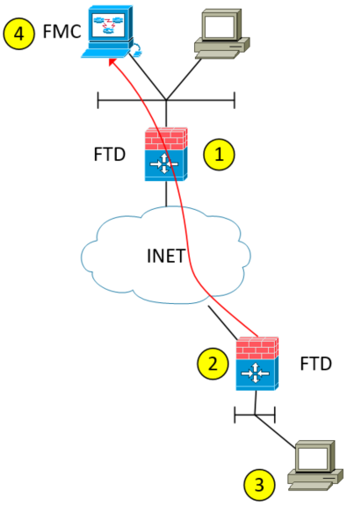
DHCP IP on Management NIC
Configure static NAT entry and outbound access for FMC through existing edge device.
Cable and configure Management NIC on INET side.
Use a DHCP IP issued from ISP.
Issue the command configure manager add <static NAT IP of FMC> <shared key> <NAT ID> on FTD’s CLI.
Add FTD into FMC
Host:
Registration Key: <shared key>
NAT ID: <NAT ID>
The FTD will then attempt to establish communication with FMC and the registration process will ensue.

Slide 35
FTD Deployment Modes

Slide 36
FTD Deployment Modes
FTD is built to be a firewall thus:
Routed
Transparent
Notes:
No multiple context mode available on FTD today.
Routed or transparent mode configured with setup dialog.
Changing between these modes requires re-registering with FMC.
Policies will be re-deployed.
Optional interface modes can be in these IPS/IDS modes:
Inline
Inline Tap
Passive

Slide 37



FTD Deployment Modes (cont.)
Routed – The traditional mode of the firewall.
Two or more interfaces that separate L3 domains.
The FTD is the Router and Gateway for local hosts.
Static routes, RIP, OSPF, and BGP are supported.
Fail-open is NOT supported.
10.1.1.0/24
10.1.1.1
NAT
DRP
192.168.1.1
192.168.1.0/24
IP:192.168.1.100 GW: 192.168.1.1

Slide 38
FTD Deployment Modes (cont.)
192.168.1.1
Transparent Mode is where the firewall acts as a bridge functioning at L2.
Transparent mode firewall offers some unique benefits in the DC.
Transparent deployment is tightly integrated with our ‘best practice’ data center designs.
VLAN192
VLAN1920
192.168.1.0/24
IP:192.168.1.100 GW: 192.168.1.1

Slide 39
IPS/IDS Modes
“Extract” a few of the FTD device’s interfaces from firewall mode and apply IPS/IDS mode.
Traffic process by minimal ASA functions and all SNORT processes.
Packet not impacted in Inline Tap or Passive modes but could be dropped either by ASA or SNORT in Inline mode.

Slide 40
Inline Mode
Two physical interfaces paired together.
Paired interfaces must be assigned to an inline set.
Bump in the wire, entirely transparent to the network.
Easy to insert into an existing network.
Multiple pairs can be configured on same sensor as sets.

Slide 41
Inline Tap Mode
Same as Inline but packets are never dropped.
Used for evaluating and tuning of rules.

Slide 42
Passive Mode
IDS mode
Separate device must send copies of the packets.
SPAN (or monitor) from a switch.
Network Taps.
One or more physical ports designated as passive.
Only copies of the packets are sent to the sensor.
Does NOT impact network traffic.
Easy to insert into an existing network.
Optionally integrate with ISE to remediation recommendations.

Slide 43
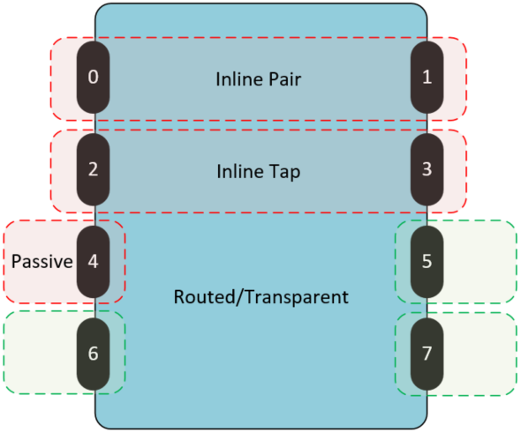
Multi-Featured NGFW
Routed / Transparent for firewall mode. (5, 6, 7)
IDS
Passive interface for monitoring copied packets from SPAN port. (4)
IPS
Inline pair to inspect traffic and take action. (0, 1)
Inline tap to inspect traffic but not take action. (2, 3)

Slide 44
FTD Security Zones

Slide 45

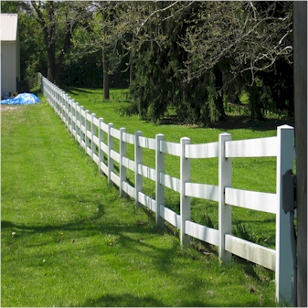
Security Zones vs. Security Levels
Security Levels are like waterfalls with one interface having a higher “level” and thus more secure than another interface.
Security Zones are like fences by dividing interfaces into “like groups” and establishing the rules for crossing the fence line.

Slide 46
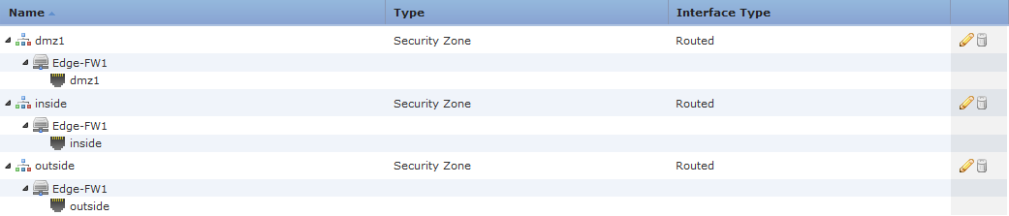
FTD Security Zones
True zone-based firewall
Security Zones are collections of interfaces or sub-interfaces
Policy rules can apply to source and/or destination security zones
Security levels are not used

Slide 47

Configuring Security Zones Considerations
Common Configuration:
“Inside” and “Outside” zones deployed to all devices.
Unique Per Site:
Unique zone name for each zone at each location.
Hybrid:
Some names are unique (such as DMZ) and other zones are common at all sites.

Slide 48
NAT on FTD

Slide 49
Network Address Translation
Two “types” of NAT in FTD devices: Auto-NAT and Manual NAT
Auto-NAT, also known as Object-NAT or Host NAT.
Defined within an object.
Just translates the source IP or IP range.
Can be a static or dynamic NAT. (Think 1:1 NAT or PAT.)
Manual NAT, also known as Twice-NAT.
Can specify the source and destination addresses for NAT.

Slide 50
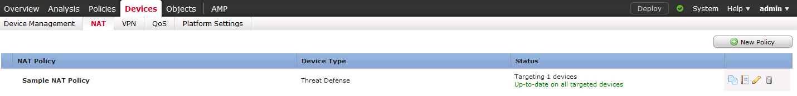
Network Address Translation (NAT)
NAT Policy
FTD Policies vs. Firepower Policies
Associated with Devices
Contains rules (edit policy to see rules)
A single NAT Policy can be applied to more than 1 device (think common policy for a group of FTD devices).

Slide 51
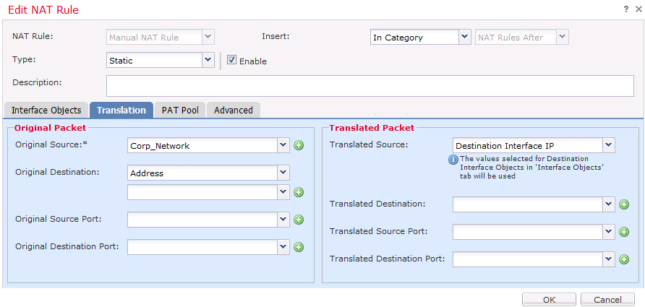
Network Address Translation (NAT) (cont.)
NAT Rule
Various settings to specify source/destination interfaces, IP addresses, Ports, etc.
Can be “Manual” or “Auto”. (More about these later.)

Slide 52
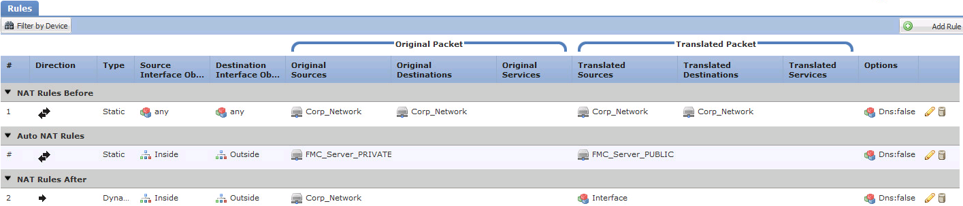
Network Address Translation (NAT) (cont.)
NAT order of operations:
Section 1 and 3 rules are manually ordered. (i.e. The administrator orders them.)
Section 2 (i.e. Auto-NAT rules) are ordered Static NAT before Dynamic NAT and then within each of those categories Longest to Shortest Prefix.

Slide 53
Configuring NAT Considerations
Common Configuration:
“Inside” to “Outside” PAT.
Unique Per Site (kind of):
Static NAT for a specific host between two security zones.
PAT using something other than “interface” IP.
Note: NAT configuration will be deployed to all devices that use the security zones listed in the NAT rules.

Slide 54
Access Control Policy (ACP)

Slide 55
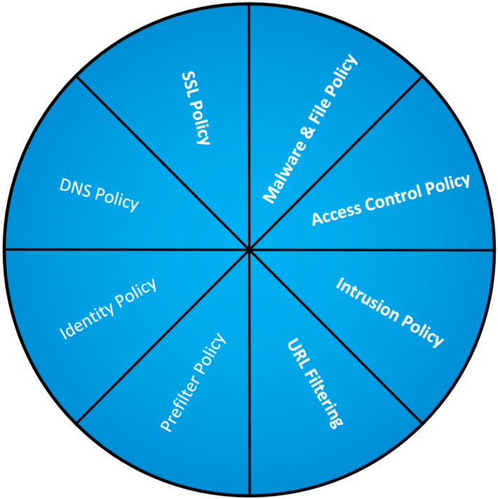
Access Control Policy (ACP)
An ACP is the collection/association point for MANY of the other policies and rules. (Think of an ACP as the gateway to applying policy to a device.)
1:N -- A single ACP can be assigned to multiple devices but a device can only be associated with one ACP.
Supports nesting/inheritance of ACPs.

Slide 56
Access Control Policy (cont.)
Policy Types:
Access Control Rule – Specify, inspect, and log network traffic
URL Filtering – Not a separate policy but configured within an Access Control Policy rule.
Intrusion – Inspect traffic for security violations
Malware & File – Detect and inspect files for malware
SSL – Inspected encrypted traffic
DNS – Controls whitelisting and/or blacklisting of traffic based on DNS
Identity – Collect identity information via captive portal
Prefilter – Early handling of traffic based on L1-L4 criteria

Slide 57
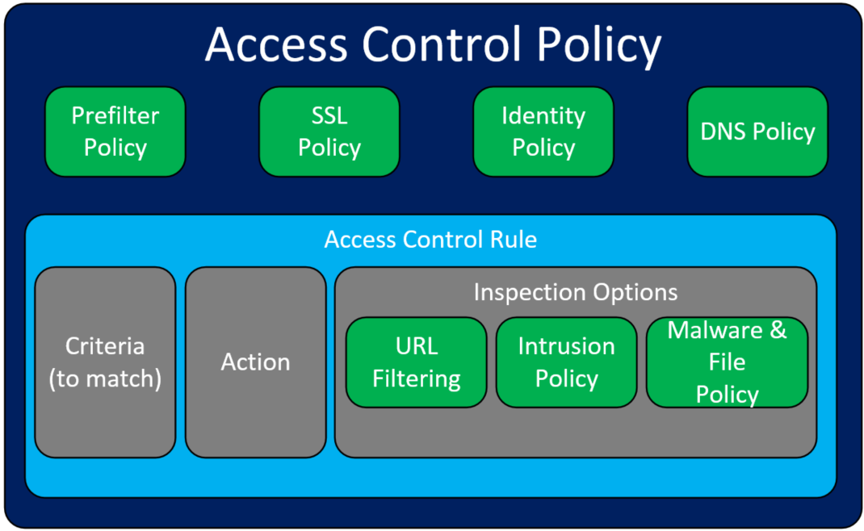
Access Control Policy (cont.)

Slide 58
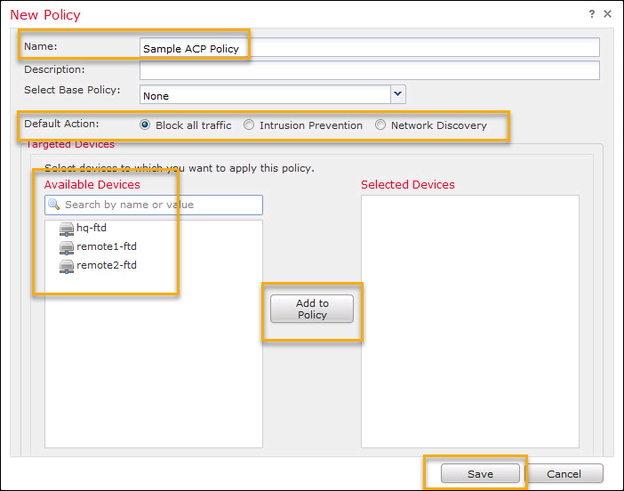
Creating an ACP
The Name and Default Action are required. All other fields are optional.

Slide 59
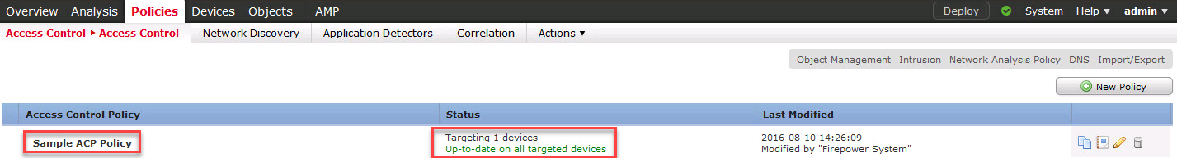
Access Control Policy (cont.)
Policy is applied on a per device basis (though multiple devices can be associated to the same policy).
Specifies a “Default Action”. (What to do if no rules apply.)
Uses an interesting inheritance association between access control policies.

Slide 60
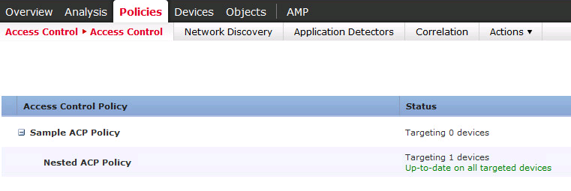
Access Control Policy (cont.)
Nested Access Control Policies.
A device can only be “directly” associated with one Access Control Policy but can get other policy’s rule via inheritance.

Slide 61
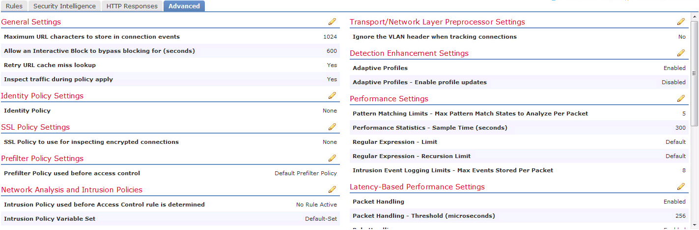
Access Control Policy (cont.)
There is a LOT more to Access Control Policies:
Security Intelligence
HTTP Responses
MANY Advanced features: SSL Policy, Prefilter Policy, Variable Set, Intrusion Policy, etc.

Slide 62
ACP Rules

Slide 63
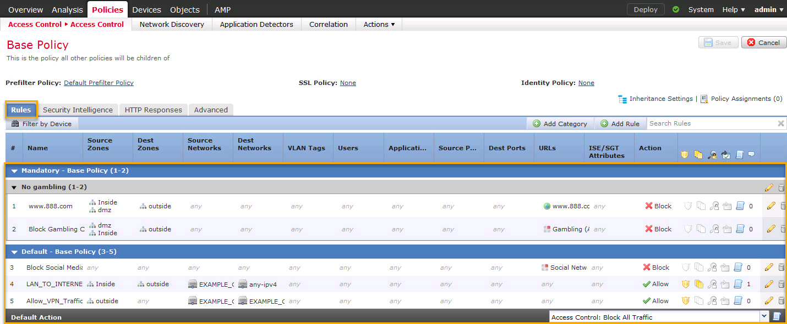
Access Control Rules

Slide 64
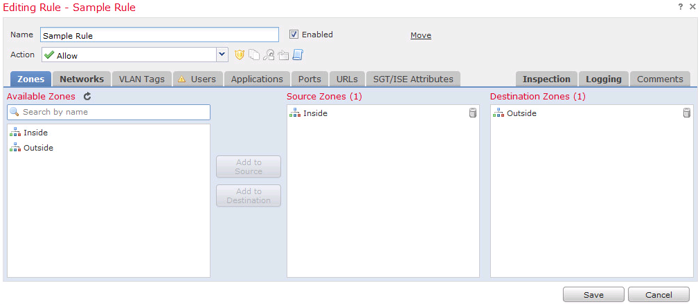
ACP Rules
A rule can match against Source/Destination Zones, IP, Ports, as well as VLAN or Security Group tags, and so much more!
A rule is also where you associate which File inspection, Intrusion/SNORT inspection, and what type of logging to do.

Slide 65
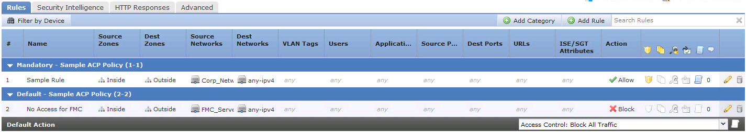
Access Control Policy (cont.)
Within an Access Control Policy rules are sorted into two sections: Mandatory and Default
Mandatory rules are checked first (top down) and then Default rules (top down).

Slide 66
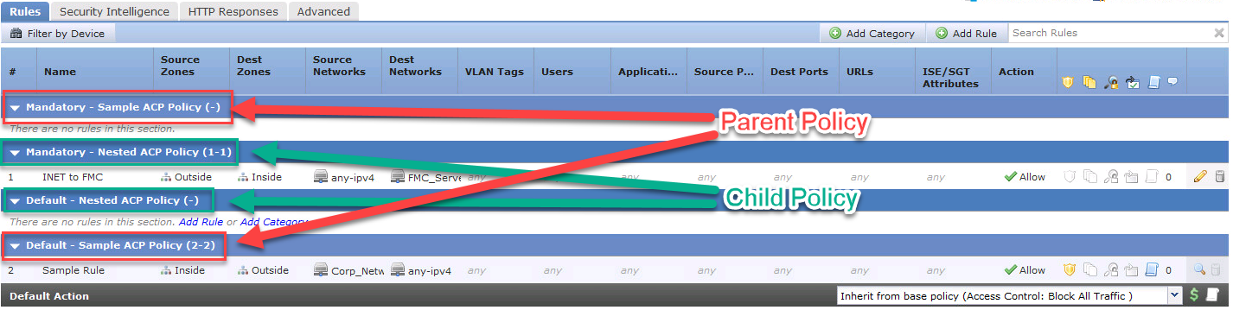
Access Control Policy (cont.)
Rules still process Mandatory prior to Default but notice that the “parent” sections sandwich the “child” sections.
Where would you put a rule to be applied no matter what any child policy rules states?
Where would you put a rule that should be used if no child policy has a rule that matches?

Slide 67
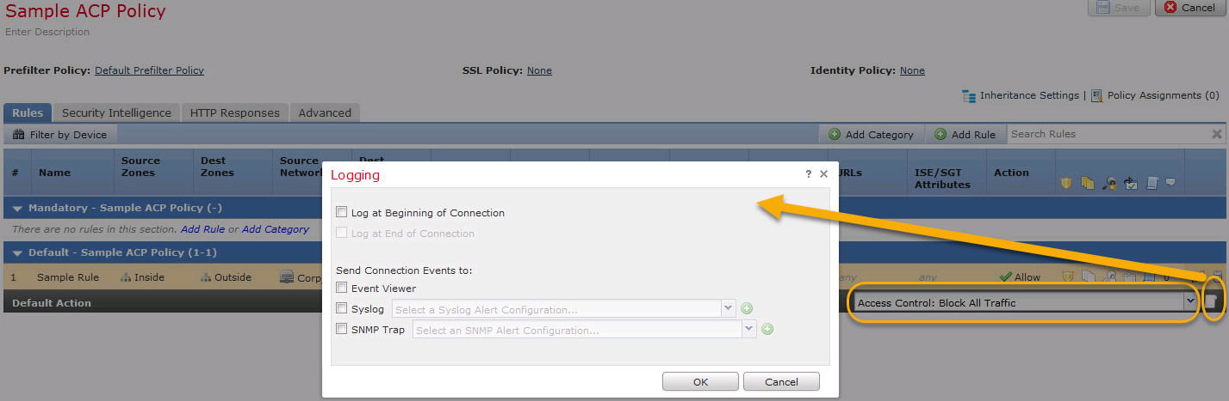
Access Control Policy (cont.)
Finally, bear in mind the “Default Action”. The action used when no other rule matches the packet flow.
When should we use the Default Action?
Should we log events that hit it?
What should the action be: Block, Trust, Discovery, Permit?

Slide 68
Configuring ACP and ACP Rule Considerations
Common Configuration:
Don’t permit traffic sourced from non-company IP address ranges outbound?
Common “Default Action”?
Unique or Subset Configuration:
Sort devices by “location type” (i.e. HQ, branch, DC, etc.) and apply ACP rules to each location type.

Slide 69
Access Control Policy (cont.)
ACP Rules are applied directly to an ACP.

Slide 70
URL Filtering

Slide 71
Minimize your exposure to web-based threats
Block specific URLs
Restrict categories of URLs
Change policies easily
Restrict access to specific sites and subsites
Filter out over 280 million URLs based on any of the 80+ categories into which they are grouped; new URLs are added daily
Use the refined user interface to make additions or changes with just a few clicks
✗
Gambling
bad_url.com
✓
Social Media
Allowed
Restricted
✓
Health
office365.com
✗
Gaming
✗
Drug Use

Slide 72
Licensing

Slide 73
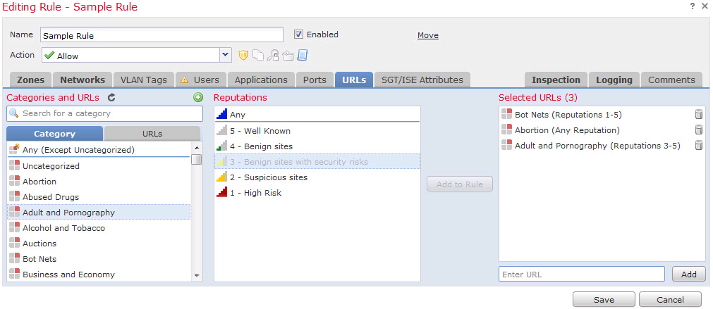
URL Filtering
Filter based on Category and/or Reputation, or via a specific URL (an object manually created, a list of URLs, or an automatically updated list of URLs).
Note: To use category and/or reputation requires URL License.

Slide 74
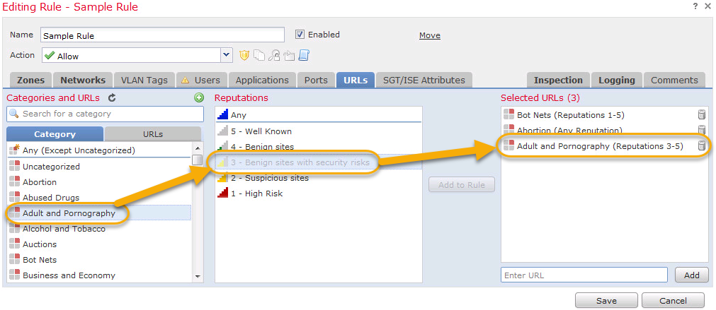
URL Filtering (cont.)
Select a category and then optionally choose a reputation.
Notice how any reputation score equal to or higher is also selected.
Uses Cisco Security Intelligence to define what URLs match these categories and reputations.

Slide 75
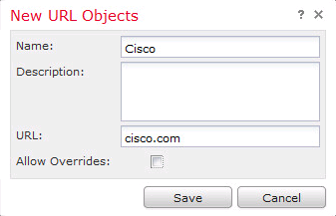
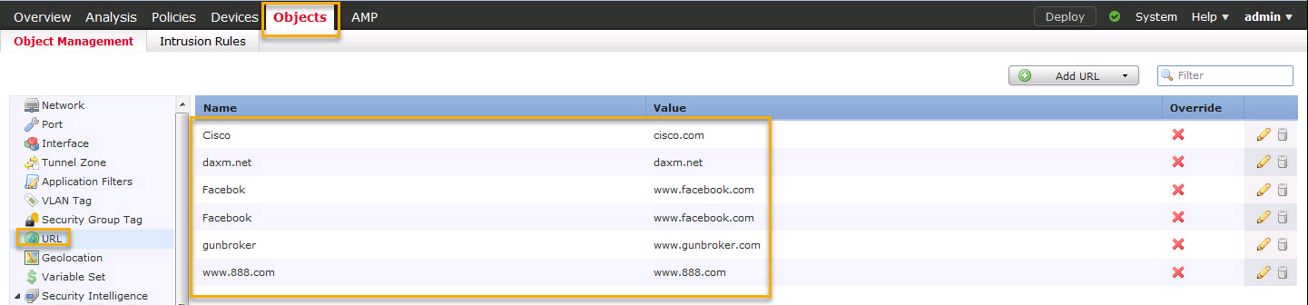
URL Object
A URL object defines a single URL or IP address
Performs a simple substring match
Disregards the protocol (HTTP/HTTPS)

Slide 76
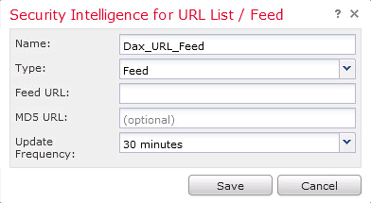
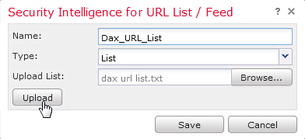
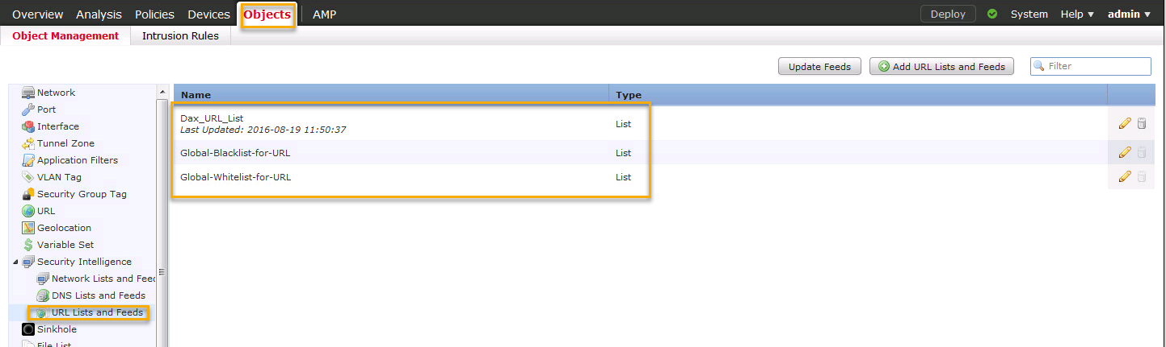
URL List and Feed
A URL list is a text file of specific URLs
A URL feed is a continuously updated list of URLs

Slide 77
Access Control Policy -- Revisited
URL Filtering is applied within an ACP Rule.

Slide 78
Malware & File Policy

Slide 79
Malware & File Policies
Malware = AMP
Controls what and how files are allowed, blocked, and inspected
Simple policy applies the same action (Malware Cloud Lookup) to all files
Actions are:
Detect Files: Detect and log the file transfer, perform no inspection
Block Files: Block and log the file transfer, perform no inspection
Malware Cloud Lookup: Inspect the file to determine disposition (Malware, Unknown, or Clean) and log
Block Malware: Inspect the file to determine disposition, log and block if Malware
Inspection includes static analysis of the file (via Spero), dynamic analysis (via AMP Threat Grid), and local analysis (via ClamAV)
Complex policies can include different actions and levels of inspections for different application protocols, directions, and file types.

Slide 80
Licensing

Slide 81
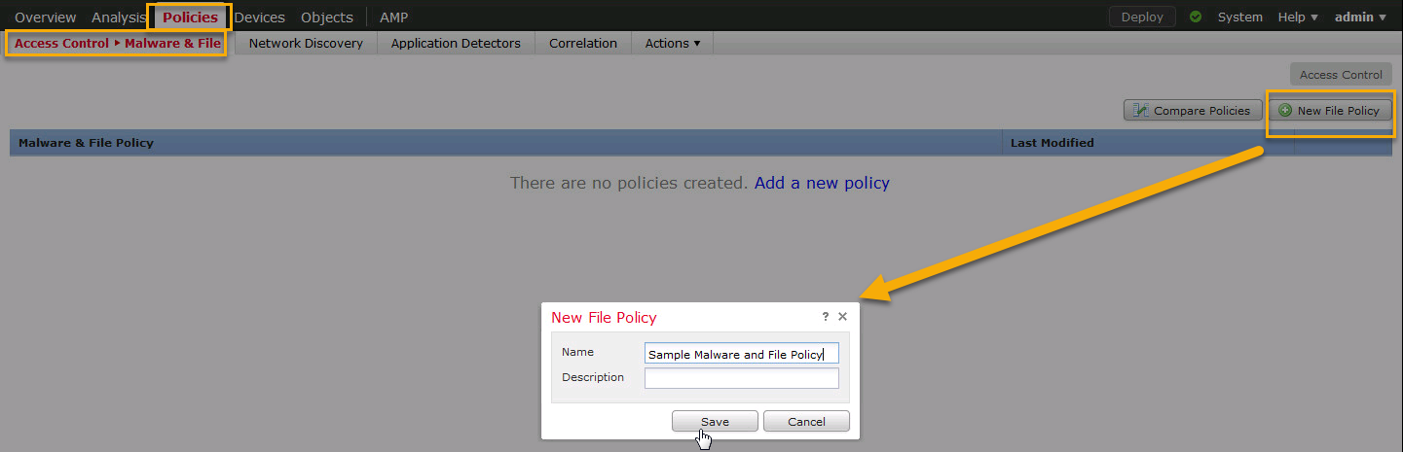
Malware & File Use Case
Block malicious Office, Executable, and PDF files transferred over HTTP

Slide 82
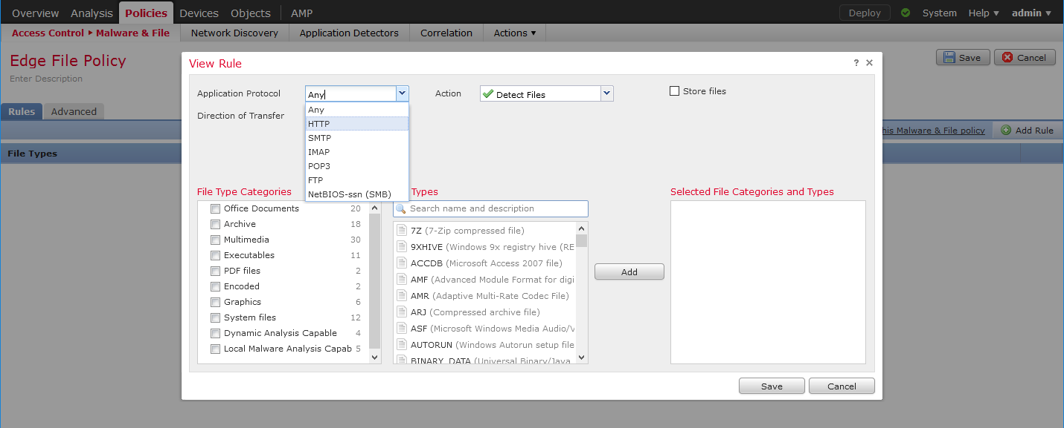
Malware & File Use Case (cont.)
Block malicious Office, Executable, and PDF files transferred over HTTP

Slide 83
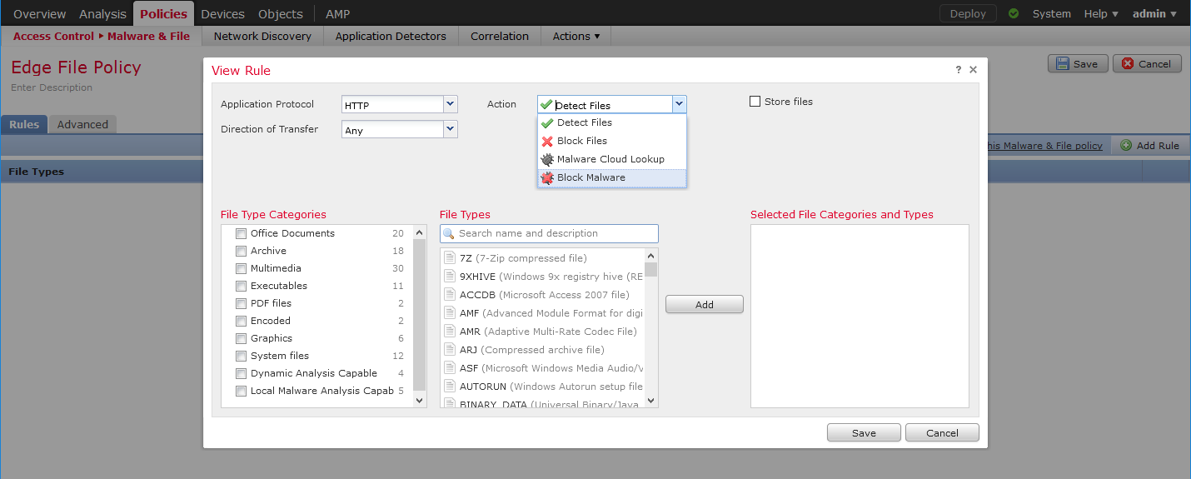
Malware & File Use Case (cont.)
Block malicious Office, Executable, and PDF files transferred over HTTP
Blocks all files matching policy file type(s)
Detection only
(no blocking)

Slide 84

Malware & File Use Case (cont.)
Block malicious Office, Executable, and PDF files transferred over HTTP
Stores files on sensor for further investigation by analyst
Spero = Static Analysis
Dynamic Analysis = Upload of the file to the cloud for analysis
Capacity Handling = Store file and resubmit if file submission limit exceeded
Local Malware Analysis = Local ClamAV signature scanning

Slide 85

Malware & File Use Case (cont.)
Block malicious Office, Executable, and PDF files transferred over HTTP

Slide 86

Malware & File Use Case (cont.)
Block malicious Office, Executable, and PDF files transferred over HTTP

Slide 87

Malware & File Use Case (cont.)
Block malicious Office, Executable, and PDF files transferred over HTTP

Slide 88
Access Control Policy -- Revisited
Malware & File policy is applied on a per ACP rule basis.

Slide 89
SSL Policy

Slide 90
SSL Policies
Controls how and what encrypted traffic is inspected and decrypted
Simple policy blocks all encrypted traffic that uses a self-signed certificate.
Actions are:
Decrypt – Resign: Used for SSL decryption of public services (Google, Facebook, etc.)
Decrypt – Known Key: Used when you have the certificate’s private key
Do not decrypt
Block
Block with reset
Monitor
Many actions can be taken on encrypted traffic without decryption by inspecting the certificate, DN, cert status, cipher suite, and version (all supported by FTD).

Slide 91
Noob Guide to SSL Encryption for HTTPS
Computers agree on how to encrypt.
Client’s browser attempts to connect to SSL port on server. It sends a preferred Key, Cipher, Hash, (AKA Cipher Suite) and SSL version to server. (Client also sends a random number that will be used to create a master secret code.)
Server responds with what Cipher Suite and SSL version it can do.
Client’s browser requests web server identity.
Server sends certificate to the client.
Browser checks whether SSL Certificate is trustworthy.
Is certificate self-signed or signed via certificate authority that the client computer trusts.
Browser sends a “Start Encrypting” message to server. (Note: This is the last unencrypted transmission.)
Server sends back “Start Encrypting”, digitally signed ACK, to start session.
Encrypted data is shared.

Slide 92
Basic 4 Use Cases for SSL
Known Key
Unknown Key
Don’t Decrypt
Block

Slide 93

Basic 4 Use Cases for SSL (cont.)
Known Key
Install server’s private key into NGFW.
NGFW will then decrypt, inspect, and re-encrypt with server’s key.
Unknown Key
Don’t Decrypt
Block

Slide 94

Basic 4 Use Cases for SSL (cont.)
Known Key
Unknown Key
Install trust of NGFW as CA in workstations.
Create NGFW key.
Decrypt SSL, inspect, and then re-encrypt with NGFW’s key.
Don’t Decrypt
Block

Slide 95

Basic 4 Use Cases for SSL (cont.)
Known Key
Unknown Key
Don’t Decrypt
Acknowledge SSL use but just pass through (supposedly).
Block

Slide 96

Basic 4 Use Cases for SSL (cont.)
Known Key
Unknown Key
Don’t Decrypt
Block

Slide 97

Create SSL Policy

Slide 98

Create SSL Rule
For public servers (you don’t control)
For servers you control

Slide 99

Assign SSL Policy to ACP

Slide 100
Access Control Policy -- Revisited
SSL Policy is applied at the Access Control Policy level thus “affects” all policies/rules associated with the devices assigned to this ACP.

Slide 101
SafeSearch/YouTube EDU

Slide 102

What is SafeSearch/YouTube EDU?
SafeSearch is an “app” that certain search engines provide that will filter out inappropriate content from search results.
YouTube EDU is an extension of the SafeSearch feature that targets YouTube content.
SafeSearch can be manually turned on within google.com. (Per browser, per device, per user)
It could then also be turned off by the end user.

Slide 103

Configure ACP Rule for SafeSearch
In an ACP Rule, on the Applications tab, click the SafeSearch link.
Enable Safe Search.
Choose what to do about search engines that don’t support Safe Search.
Build remaining criteria for ACP rule to match traffic you want.

Slide 104

Supported Search Engines for SafeSearch

Slide 105

Warning that it is a 2-step process

Slide 106

Configure SSL Policy Rule for SafeSearch
Create SSL Policy Rule.
On the Applications tab search for and select “search engine” category.
Rule’s action must be “Decrypt – Resign”.

Slide 107

Associate SSL Policy to ACP
More information about SSL Policies will be provided later in the lecture.

Slide 108

SafeSearch Permanently Enabled
Even if user tries to disable SafeSearch the page will reload and SafeSearch will remain “on”.

Slide 109

Configure ACP Rule for YouTube EDU
Create an ACP Rule and on the Applications tab click the YouTube EDU link.
Enable YouTube EDU.
Enter your YouTube EDU ID.

Slide 110

Configure SSL Policy Rule for YouTube EDU
Create an SSL Policy Rule.
On the Applications tab click search for and select YouTube Applications.

Slide 111
Associate SSL Policy to ACP
More information about SSL Policies will be provided later in the lecture.

Slide 112

YouTube Blocked Content Message

Slide 113

Order of ACP rules is Important!

Slide 114
Network Discovery

Slide 115

Network Discovery Customization
By default Network Discovery examines ALL traffic traversing the FTD (i.e. 0.0.0.0/0 and ANY zone.)
Create new network discovery rule or modify default to meet you needs.
Can create exclusion rules to single out exceptions.

Slide 116

Network Discovery Results

Slide 117

Host Profile of Discovered Host

Slide 118

Host Profile of Discovered Host (cont.)

Slide 119
Uses of Discovered Information
Firepower Recommendations for customized Intrusion Policies.
Indications of Compromise.
User to Machine correlation.
Which applications are being used on this network.
Vulnerabilities report for each host.

Slide 120
Intrusion Policy

Slide 121
Intrusion Policies
Controls how IDS/IPS inspection is performed on network traffic.
Cisco Talos maintained base policies (the default policies):
Balanced Security and Connectivity: Default and recommended
Security Over Connectivity: More rules enabled, deeper inspection (at a cost)
Connectivity Over Security: Fewer rules enabled, only most critical rules block
Maximum Detection: Favors detection over rated throughput. Use only if TAC says so.
No Rules Active: Disable SNORT for this ACP rule.
Individual rules can be set to generate events, drop and generate events, or disabled.
Layers allow for grouping of settings/rules for easier management
Complex policies can contain multiple layers and multiple levels of inheritance.

Slide 122
Licensing

Slide 123

Intrusion Policy to ACP Rule Association

Slide 124

Create Intrusion Policy

Slide 125

Intrusion Policy’s are Highly Customizable

Slide 126

Firepower Recommendations

Slide 127

Firepower Recommendations (cont.)

Slide 128
Access Control Policy -- Revisited
Intrusion policy is applied on a per ACP rule basis.

Slide 129
Rate Limiting/QoS

Slide 130

Create QoS Policy
Devices > QoS
Click New Policy
Give Name
Assign FTDs
Save

Slide 131

Order of Match

Slide 132
Caveats/Limitations
Max 32 QoS rules
Constrain rules by src/dest (routed) interfaces.
Rate limiting is enforced independently on each interface (not aggregated and/or differently based on src/dest interface pairs).
QoS rules can rate limit traffic by:
Transport/network layer characteristics: IP address or geolocation, port, protocol
Contextual information: Application control, URL filtering
User information: realm, user, user group, ISE attribute
Ingress and Egress can be rate limited independently.

Slide 133
FTD Packet Flow

Slide 134

Packet Flow Through FTD

Slide 135

Packet Flow Through FTD (cont.)
Packet arrives on the ingress interface.
Input counters incremented by NIC and periodically retrieved by CPU.
Software input queue (RX ring) is an indicator of packet load.
Overrun counters indicates packet drops (usually packet bursts)

Slide 136

Packet Flow Through FTD (cont.)
If existing connection exists bypass Untranslate NAT and ACL steps. Process in Fastpath.
Otherwise:
If TCP packet but NOT SYN packet, drop and log.
Process through NAT to untranslate destination IP addresses, if applicable. Note: This is NOT the actual NAT phase. Just “un-NAT” enough to run through ACLs. ACL checks are done on the “untranslated” IP addresses.

Slide 137

Packet Flow Through FTD (cont.)
If no Fastpath:
Check IP Reputation / Security Intelligence Lists.
Drop packet if blacklisted.
Application Identification (think AVC)
Attempt to identify and categorize packet to an application.
Enforce policy rules
Note: Firepower policies don’t actually drop the packet. They flag the packet to be dropped and Lina drops the packet.
Generate an event log.

Slide 138

Packet Flow Through FTD (cont.)
Perform Application Layer Gateway checks (think fixup)
Perform NAT translation (in preparation for exiting the FTD device):
Translate the source and destination IP addresses in the IP header.
Translate the port if performing PAT.
Update header checksums
More about the types of NAT later in this presentation (Auto vs. Manual).

Slide 139

Packet Flow Through FTD (cont.)
Packet is “virtually” forwarded to egress interface. (Not actually forwarded yet.)
Egress interface is determined first by translation rule or existing connection entry THEN the routing table
If NAT does not divert to the egress interface, the global routing table is consulted to determine the egress interface.
Once at egress interface, route lookup is performed.
Only routes pointing out of selected egress interface are considered.
If the destination is not routable out the selected egress interface the packet is dropped.
Once L3 route is found L2 resolution is performed (i.e. ARP).
If L2 resolution fails the packet is dropped.
Packet is transmitted on the wire and interface counters will increment.
Underrun counters indicates drops due to egress interface oversubscription. (TX ring is full.)

Slide 140
Reports and Dashboards

Slide 141

Dashboards

Slide 142

Dashboards (cont.)

Slide 143

Report Templates

Slide 144

Report Designer

Slide 145

Generated Reports

Slide 146

Generated Reports (cont.)

Slide 147

Device Monitoring

Slide 148

Management Monitoring

Slide 149
VPN on FTD

Slide 150

VPN on FTD
Site to Site (only)
Remote access (i.e. AnyConnect) not in v6.1.
Topologies:
Point to Point
Hub and Spoke
Full Mesh

Slide 151


Point to Point Example

Slide 152

Hub and Spoke Example

Slide 153

Full Mesh Example

Slide 154

Verification and Monitoring VPN

Slide 155
Application Program Interface (API)

Slide 156
API on FMC
Issue API calls to FMC
API-Explorer
External script (python, perl)
Cannot “push” to FTD (yet)
Good for regular/mass repetitive changes (PUT or POST or DELETE)
Great for regularly retrieving JSON formatted information (GET)
Use to updated 3rd party and/or in-house external monitoring tools
A username can only uniquely log into FMC via HTTPS once. If that username attempts to log in a 2nd time their 1st connection will be logged out.
Creation of a special “API User” might be best to avoid HTTPS access collisions since API calls and web page calls are treated the same.

Slide 157

API Explorer
https://<fmc IP>/api/api-explorer

Slide 158

API Explorer (cont.)

Slide 159

Exporting a Generic Script

Slide 160

Standalone Scripting
Import the needed libraries
Provide the FMC IP/hostname
Either pass the username/password as arguments when running the script or embed them into the script.
Either use/import certificates to communicate with FMC or disable SSL verification (as shown).

Slide 161

Standalone Scripting (cont.)
Configure the API call path with any parameters desired.
Like shown in step 4, either use/import certificates to communicate with FMC or disable SSL verification (as shown).

Slide 162

Standalone Scripting (cont.)

Slide 163
Upgrade ASA to FTD Code

Slide 164
Caveats
Read the release notes!
Supported ASA Platforms: ASA 5506-X, ASA 5506H-X, ASA 5506W-X, ASA 5508-X, ASA 5512-X, ASA 5515-X, ASA 5516-X, ASA 5525-X, ASA 5545-X, and ASA 5555-X
Minimum ASA version: 9.6.1 (or later)
Minimum ROMMON Mode: 1.1.8
Note: 5585 will NOT support FTD!
Remember this is a complete format and reimage. All files, codes, images, configs on the ASA will be lost during this process!

Slide 165

Install Boot Image
Enter ROMMON
Press ESC when prompted.
Configure ROMMON Variables
“set” will list variables and their values.
Variables are CaSe SeNsiTiVe!
There is no “space” between variable, equal sign, and value.
“sync” to save changes.
Ensure connectivity (i.e. ping) to the TFTP server.
Note: Some ASA appliances require a “.cdisk” file and others use a “.lfbff” file.

Slide 166

Install Boot Image (cont.)
Issue “tftpdnld” command to start the downloading of the image.

Slide 167

Install Boot Image (cont.)
ASA will reboot.
Be ready to press ESC to boot the boot image!!!
This is the trickiest part of this upgrade since you have to be ready to press ESC or the ASA will just boot up its standard image and you’ll have to start over!

Slide 168

Install FTD Image
Issue “setup” command.
Fill out questionnaire to provide access to FTP/HTTP server where FTD image resides.
Apply changes and reboot.

Slide 169

Install FTD Image (cont.)
Issue “system install” command.
Confirm erasure.
If needed, provide credentials for FTP server.

Slide 170

Install FTD Image (cont.)
Confirm performing upgrade.
Once done, reboot.

Slide 171
Set up Firepower Device Manager

Slide 172

Firepower Device Manager
On box/locally managed
Use when no FMC is available/reachable.
Switching from “locally managed” to “FMC managed” WILL erase the local configuration!

Slide 173
Accessing the GUI
Access, via HTTPS, the device’s management IP.
Log in using admin account. (By default this is admin/Admin123.)

Slide 174
Take the Defaults, or not.
The Defaults
Interfaces:
0/1 is “inside”
0/2 is “outside”
Management is assumed to be on “inside” LAN.
IPs:
Management: 192.168.45.45
Inside: 192.168.45.0/24
Outside: DHCP
DHCP Pool
192.168.45.0/24 pool for “inside”.
Accounts:
admin/Admin123
Note: Click “Skip device setup” to build it to your design.

Slide 175

Eval Licensing

Slide 176


Disable DHCP and Remove DHCP Pool

Slide 177

Configure to your liking
Set data plane interface names.
Set data plane interface IPs.
Configure routing. (Default route at least if no DHCP for “outside”.)
Assign interfaces to zones.
Configure NAT.
Don’t forget to Deploy!

Slide 178
Cisco Healthcheck and Tuning Services

Slide 179
Cisco Healthcheck & Tuning Services – Subject Matter Expert
Product SKU (applicable) | Services SKU (s) | Segment | Geo | Lifecycle
All security Products | ASF-CORE-G-SSME1L (AMER – Travel Inc) ASF-CORE-G-SSME1W (APJC & EMEA, No Travel) ASF-CORE-G-SSME1I (APJC & EMEA, International Travel) Transactional AS-SEC-SME | All | All | Plan & Build
Typical skill set or expertise of Cisco personnel providing services is as follows:
• In-depth Subject Matter Expertise knowledge of the selected Cisco Security Product and varying knowledge from general to expert levels with other Cisco and 3rd Party Security Product technologies.
• Expertise in integrating, operating, and managing the Cisco Security Product within diverse Customer environments providing an end-to-end professional security experience.
• Ability to analyze security requirements and specify hardware and software requirements, including security management tools.
• Ability to understand, identify and mitigate security risks that affect compliance requirements.
• Knowledge in migrating from existing products to the selected Cisco Security Product.
• Experience in developing an in-depth security architecture.
• Assessment of the network’s readiness to deploy a new security solution, including the existing IT infrastructure, security devices, software operations, and security management procedures.
• Ability to assist Customer in the planning, design, and implementation of security solutions.
• Proficiency in the development of detailed security designs, including network diagrams, system rules and reports, and sample software configurations for protocols, policies, and features.
• Assistance in testing a pilot security solution to confirm that expected performance is attained.
• Development of an implementation strategy and plan detailing the requirements for solution deployment, integration, and management.
• Expertise in support of custom installation, configuration, testing, tuning, and integration of a security solution.

Slide 180
Cisco Security Migration Services (ASA/Firepower)
SKU (s) | Segment | Geo | Lifecycle
AS-SEC-CNSLT (US, CAN, EUROPE) AS-SEC-CNSLT-A (APJC AS-SEC-CNSLT-L (Emerging) | All | All | Plan & Build
Security Migration Services can help migrate from a current security environment to a more innovative security infrastructure that provides proactive ongoing protection, and gives a clear understanding of the risks in the current environment and outline the best possible migration strategy.
Transactional ASA Migration Services
The transactional ASA Migration services covers more complex, enterprise level firewall configuration migrations, including PIX, Check Point, and Juniper firewalls to the ASA platform. These services cover multiple platforms, enterprise-wide features, functionality and complexity.
These services are SOW based, custom scoped and delivered.
Benefit from Cisco Migration Services
The right level of security provides the confidence to freely engage in new business opportunities and initiatives with customers, partners, and employees. Available either on site or remotely, Cisco Security Migration Services deliver an array of benefits, including:
Improved methods to reduce disruptions and the risks of costly rework during and after migration
Efficiencies to help you increase the capabilities from your investment through thorough plan reviews
Focused support and guidance through crucial transition periods
Improved network uptime during migration through the use of proven processes and tools
Reduced risks of lost business before, during, and after migration
Accelerated migration to advanced security platforms
Ongoing support and knowledge transfer when requested

Slide 181
Deployment Services for Firepower Solutions
Product SKU | Services SKU(s) | Segment | Geo | Lifecycle
Firepower ordering guide | ASF-CORE-FW-DEP (AMER) ASF-CORE-FW-DEP-NT (APJC, EMEAR No travel) ASF-CORE-FW-DEP-IT (APJC & EMEA International Travel) | All | All | Plan & Build
This Service covers the following managed devices and Firepower Solution components:
One (1) standalone or one (1) High-Availability pair management solution from the following options:
FireSIGHT Management Center (FMC)
Firepower Management Center (FMC)
Up to ten (10) total managed devices from the device platform types listed below, of which four (4) may be Firepower Threat Defense instances:
FirePOWER Appliances
Virtual FirePOWER Appliances
FirePOWER Modules (ASA or ISR)
Firepower NGFW Appliances
Firepower Threat Defense (FTD) on ASA Appliances
Virtual Firepower Threat Defense

Slide 182

Thank you!
Additional Information:
CiscoLive BRKSEC 2020 (Firewall Deployment FTD)
CiscoLive BRKSEC 2050 (ASA Firepower NGFW typical deployment scenarios)
Important Links:
Quick Start Guide
Release Notes
Configuration Guide
Questions?

